Slide 1
VEHICLE SALES DASHBOARD
Data Analyst Internship – Task 4
Dashboard Design
Name:Amrutha M R
College:JNNCE

Slide 2
OBJECTIVE & DATASET
Objective: Design an interactive dashboard for business stakeholders.
Dataset: Vehicle sales data.
Tool: Microsoft Power BI.
Focus: Sales performance, vehicle characteristics and trends.

Slide 3
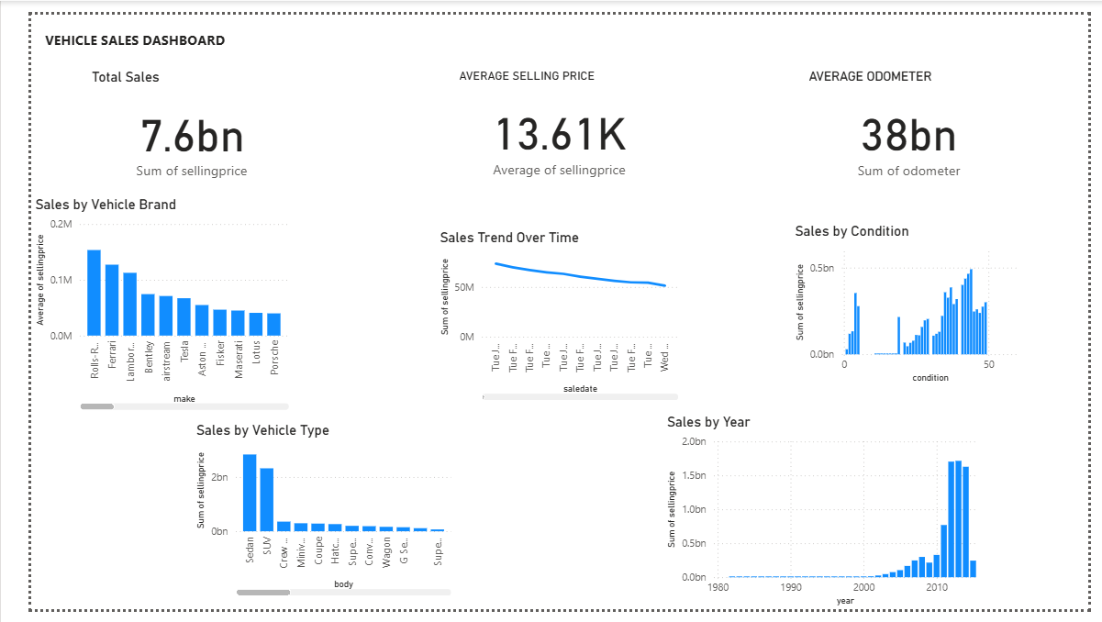
DASHBOARD OVERVIEW
Key Performance Indicators:
• Total Sales: approximately 7.6B
• Average Selling Price: approximately 13.61K
• Average Odometer: vehicle mileage indicator
Charts include sales by brand, sales trend, condition, vehicle type and year.

Slide 4
KEY INSIGHTS
• Sales can be compared across different vehicle brands.
• The sales trend shows how vehicle sales vary over time.
• Vehicle condition can be compared using selling price.
• Different vehicle types contribute differently to overall sales.
• Year-wise analysis helps identify changes in sales performance.

Slide 5
CONCLUSION
The Vehicle Sales Dashboard provides a clear visual summary of sales performance.
Power BI visuals make it easier to compare brands, vehicle types, condition and yearly trends.
The dashboard can support business stakeholders in understanding vehicle sales patterns.

